Slide 1
CEN 414:Computer Software Engineering I
Fundamental of Object-Oriented Design.
BY OMORUYI O.

Slide 2
Topics (Module 2)
Language Specific Features (e.g. JAVA, C#, Python): Runtime Environment & VM, Compilers, Interpreters, etc.
Numerical data, variable, constants, and arithmetic expressions.
Language Basics(e.g. JAVA, C#, Python): Standard input and output statements. Escape sequences, math class.

Slide 3
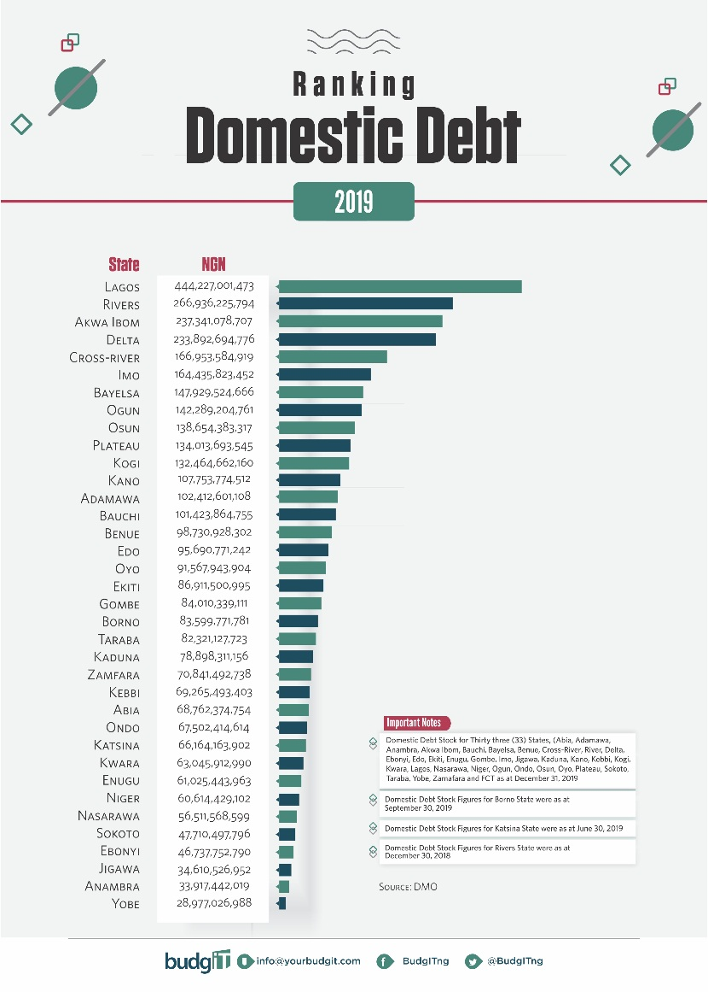
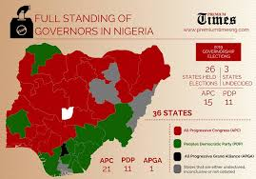
Assignment Two Infographics/ Statistical Presentations

Slide 4
Java (Origins, Runtime Environment & VM)
The Java language was developed at Sun Microsystems in 1991 as part of a research project to develop software for consumer electronics devices—television sets, VCRs, toasters, and the other sorts of machines you can buy at any store.
Java’s goals at that time were to be small, fast, efficient, and easily portable to a wide range of hardware devices.

Slide 5
Java (Origins, Runtime Environment & VM)
Platform independence is one of the most significant advantages that Java has over other programming languages, particularly for systems that need to work on many different platforms.
Normally, when you compile a program written in C or in most other languages, the compiler translates your program into machine codes or processor instructions. Those instructions are specific to the processor your computer is running—
For example, if you compile your code on a Pentium system, the resulting program will run only on other Pentium systems. If you want to use the same program on another system, you have to go back to your original source, get a compiler for that system, and recompile your code.

Slide 6
Java (Origins, Runtime Environment & VM)

Slide 7
Java (Origins, Runtime Environment & VM)
Things are different when you write code in Java. The Java development environment has two parts: a Java compiler and a Java interpreter. The Java compiler takes your Java program and instead of generating machine codes from your source files, it generates bytecodes.
Having your Java programs in bytecode form means that instead of being specific to any one system, your programs can be run on any platform and any operating or window system as long as the Java interpreter is available.
The disadvantage of using bytecodes is in execution speed. Because system-specific programs run directly on the hardware for which they are compiled, they run significantly faster than Java bytecodes, which must be processed by the interpreter.

Slide 8
Java virtual machine/run-time environment
The Java virtual machine can be deconstructed into five fundamental pieces:
A bytecode instruction set
A set of registers
A stack
A garbage-collected heap
An area for storing methods
These five pieces might be implemented by using an interpreter, a native binary code compiler, or even a hardware chip—but all these logical, abstract components of the virtual machine must be supplied in some form in every Java system.
The virtual machine, and its supporting code, is often referred to as the run-time environment.

Slide 9
Java Bytecode instruction set
The Java virtual machine instruction set is optimized to be small and compact. As mentioned, Java source code is “compiled” into bytecodes and stored in a .class file. The compiler that performs the conversion is known as the javac tool.
The javac tool translates source code into bytecodes, a lower-level format that cannot be run directly, but must be further interpreted by each computer.
A bytecode instruction consists of a one-byte opcode that serves to identify the instruction involved and zero or more operands, each of which may be more than one byte long, that encode the parameters the opcode requires.
For example, when adding two integers, the compiler generates an iadd bytecode; for adding two floats, fadd is generated.

Slide 10
Registers
The registers of the Java virtual machine are just like the registers inside a microprocessor. The following are the Java registers:
pc - the program counter, which indicates what bytecode is being executed
Optop - a pointer to the top of the operand stack, which is used to evaluate all arithmetic expressions.
frame - a pointer to the execution environment of the current method, which includes an activation record for this method call and any associated debugging information.
Vars - a pointer to the first local variable of the currently executing method.
The virtual machine defines these registers to be 32 bits wide.

Slide 11
Java Stack
The Java virtual machine is stack-based. A Java stack frame holds the state for a single method call. Frames for nested method calls are stacked on top of this frame.
The stack is used to supply parameters to bytecodes and methods, and to receive results back from them.

Slide 12
Java Stack frame
Each stack frame contains three (possibly empty) sets of data: the local variables for the method call, its execution environment, and its operand stack.
Local variables are stored in an array of 32-bit slots, indexed by the register vars.
The execution environment in a stack frame helps to maintain the stack itself. It contains a pointer to the previous stack frame, a pointer to the local variables of the method call, and pointers to the stack’s current “base” and “top.”
The operand stack is a 32-bit first-in-first-out (FIFO) stack used to store the parameters and return values of most bytecode instructions. For example, the iadd bytecode expects two integers to be stored on the top of the stack. It pops them, adds them together, and pushes the resulting sum back onto the stack.

Slide 13
Heap
The heap is that part of memory from which newly created instances (objects) are allocated.
In Java, the heap is often assigned a large, fixed size when the Java run-time system is started, but on systems that support virtual memory, it can grow as needed, in a nearly unbounded fashion.
Because objects are automatically garbage-collected in Java, programmers do not have to (and, in fact, cannot) manually free the memory allocated to an object when they are finished using it.

Slide 14
The Area for Storing Methods
The method area stores the Java bytecodes that implement almost every method in the Java system.
The method area also stores the symbol tables needed for dynamic linking, and any other additional information debuggers or development environments which might want to associate with each method’s implementation.

Slide 15
Java Interpreter
A bytecode interpreter examines each opcode byte (bytecode) in a method’s bytecode stream, in turn, and executes a unique action for that bytecode.
This might consume further bytes for the operands of the bytecode and might affect which bytecode will be examined next.
It operates like the Microprocessor in a computer, which examines memory for instructions to carry out in exactly the same manner.
It is the software CPU of the Java virtual machine.

Slide 16
Numerical Data, Variable Constants
Numerical data, variable, constants, and arithmetic expressions.

Slide 17
Statements
a statement forms a single Java operation.
Statements sometimes return values—for example, when you add two numbers together or test to see whether one value is equal to another.
These kind of statements are called expressions.

Slide 18
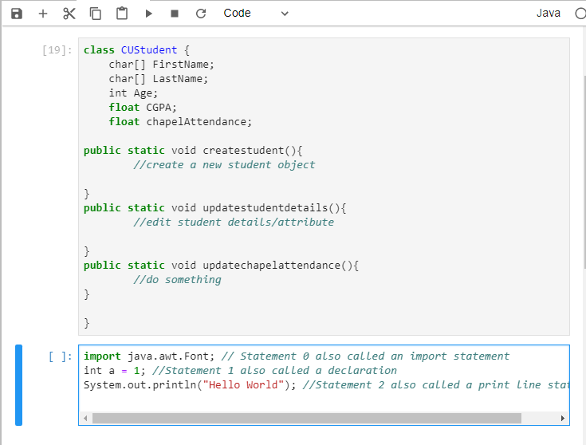
Statements

Slide 19
Statements
The most important thing to remember about Java statements is that each one ends with a semicolon. Forget the semicolon and your Java program won’t compile.
Java also has compound statements, or blocks, which can be placed wherever a single statement can.
Block statements are surrounded by braces ({}).

Slide 20
Variables
Variables are locations in memory in which values can be stored. They have a name, a type, and a value.
Before you can use a variable, you have to declare it. After it is declared, you can then assign values to it.
Java actually has three kinds of variables: instance variables, class variables, and local variables.

Slide 21
Variables: Instance, Class, Local
Instance variables are used to define attributes or the state for a particular object.
Class variables are similar to instance variables, except their values apply to all that class’s instances (and to the class itself) rather than having different values for each object.
Local variables are declared and used inside method definitions, for example, for index counters in loops, as temporary variables, or to hold values that you need only inside the method definition itself. They can also be used inside blocks ({}).

Slide 22
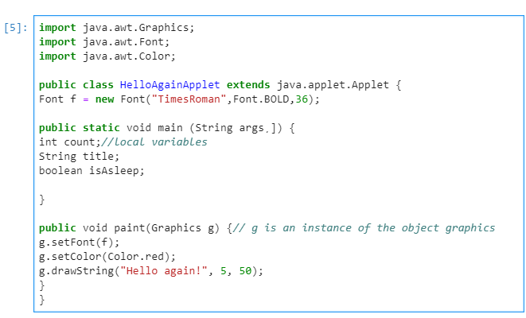
Variable

Slide 23
Variables
Variable names in Java can start with a letter, an underscore (_), or a dollar sign ($). They cannot start with a number. After the first character, your variable names can include any letter or number. Symbols, such as %, *, @, and so on, are often reserved for operators in Java, so be careful when using symbols in variable names.
In addition, the Java language uses the Unicode character set. Unicode is a character set definition that not only offers characters in the standard ASCII character set, but also several million other characters for representing most international alphabets. This means that you can use accented characters and other glyphs as legal characters in variable names, as long as they have a Unicode character number above 00C0.

Slide 24
Variables
In addition to the variable name, each variable declaration must have a type, which defines what values that variable can hold.
The variable type can be one of three things:
One of the eight basic primitive data types
The name of a class
An array

Slide 25
Variable types
integers,
floating-point numbers,
characters,
and boolean values (true or false)
There are also four integer types:
byte 8 bits –128 to 127
short 16 bits –-32,768 to 32,767
int 32 bits –2,147,483,648 to 2,147,483,647
long 64 bits –9223372036854775808 to 9223372036854775807

Slide 26
Constants
Constants are useful for setting global states in a method or object, or for giving meaningful names to object-wide values that will never change.
In Java, you can create constants only for instance or class variables, not for local variables.
A constant variable or constant is a variable whose value never changes (which may seem strange given the meaning of the word “variable”).

Slide 27
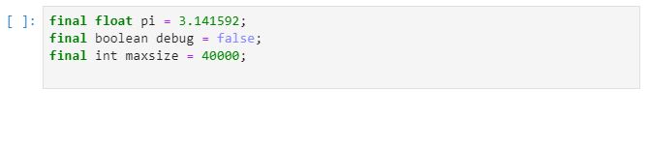
Constants
To declare a constant, use the final keyword before the variable declaration and include an initial value for that variable:

